Slide 1

Given:
f(n) = n * f(n-1)
f(0) = 1
How can I solve this using Python?
Is there a closed form for f(n)?

Slide 2

Lecture 7:
Recursion,
Data Structures I
CoTaPP: Computational Thinking and
Programming with Python
All icons by: https://www.flaticon.com/

Slide 3

Recursion: why?
Power (or exponentiation)
  non-recursive definition
    3⁵ = 3 * 3 * 3 * 3 * 3 = 243

Slide 4
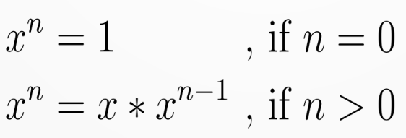
Recursion: what?
Power (or exponentiation)
  non-recursive definition
    3⁵ = 3 * 3 * 3 * 3 * 3 = 243
  recursive definition
Notes:
Explain base and recursive cases

Slide 5
Recursion: what?
f(n) = n * f(n-1)
f(0) = 1
Notes:
A recursive function is a function that calls itself

Slide 6
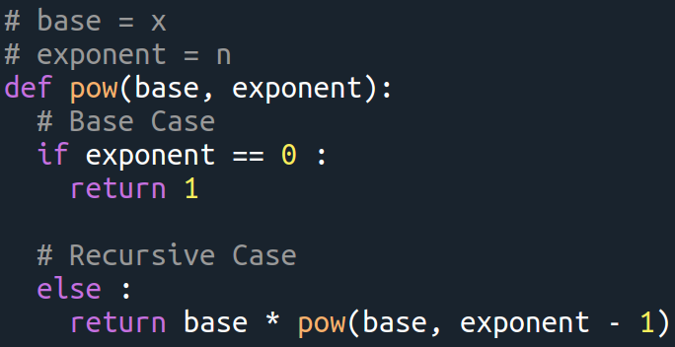
Recursion: how?

Slide 7

Write a recursive function to determine the sum of the first n natural numbers
sum(n) = 1 + 2 + 3 +……..+ n
First, think about the base case and the recursive case. Then, write the function
Notes:
Take 10 minutes for this

Slide 8
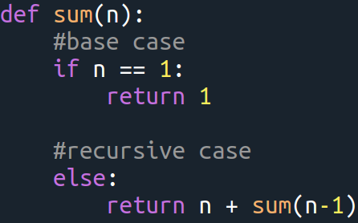

Slide 9
Data Structures in Python

Slide 10
Previous data types
Atomic:
  int (7)
  float (2.5)
  bool (False)
Collections:
  str (“apple”)

Slide 11
str as a collection
“apple” = “a”, “p”, “p”, “l”, “e”

Slide 12
str as a collection
“apple” = “a”, “p”, “p”, “l”, “e”
len(“apple”) → 5
len(5) → TypeError

Slide 13
Lists
myList = [1,3,True,6.5]

Slide 14
Lists
myList = [1,3,True,6.5]
Ordered → [1,2] ≠ [2,1]

Slide 15
Lists
myList = [1,3,True,6.5]
Ordered → [1,2] ≠ [2,1]
Mutable →
  myList[1] = 5
  print(myList) → [1,5,True,6.5]

Slide 16
Lists
myList = [1, 3, True, 6.5]
Ordered → [1, 2] ≠ [2, 1]
Mutable →
  myList[1] = 5
  print(myList) → [1, 5, True, 6.5]
Non-unique → [1, 1, True, 6.5]

Slide 17
Lists
myList = [1, 3, True, 6.5]
Iterable →
  for el in myList:
  print(el)
  → 1
  3
  True
  6.5

Slide 18
Operations on lists
myList = [4, 1]
Name | Operator | Example
Indexing | [] | myList[0] → 4
Concatenation | + | myList + [2] → [4, 1, 2]
Repetition | * | myList * 2 → [4, 1, 4, 1]
Membership | in | 1 in myList → True
Length | len | len(myList) → 2
Slicing | [:] | myList[1:2] → [1]

Slide 19
Methods for lists
myList = [4, 1]
Name | Use | Returns | myList after
append | myList.append(2) | None | [4, 1, 2]
insert | myList.insert(0, 2) | None | [2, 4, 1]
pop | myList.pop(0) | 4 | [1]
sort | myList.sort() | None | [1, 4]
reverse | myList.reverse() | None | [1, 4]
index | myList.index(4) | 0 | [4, 1]
count | myList.count(1) | 1 | [4, 1]
remove | myList.remove(4) | None | [1]

Slide 20
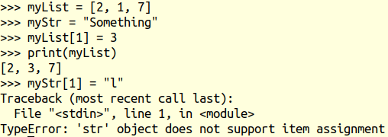
Mutability

Slide 21


Slide 22
1-minute paper
recursion, lists, mutability
Notes:
Take 2 minutes for this

